Slide 1

MIS 547
Cloud Computing

Slide 2
Lecture 15
Container Orchestration Day 2

Slide 3
Admin
Assignment 7 is a hybrid assignment for Weeks 8 &9
01
Quiz Opens Today @ 5pm, Due Sunday October 20th
03
Assignment 7 will be due on Sunday, October 27th
02
Mid-semester project update October 31!
04
Prof Z traveling next week- lectures will be asynchronous online
05

Slide 4
AGENDA
What’s covered in this lecture:
Agenda
What’s covered next:
Kubernetes, continued
Kubernetes,
More Kubernetes and CICD
Other Container Orchestration Options
Managed K8 options
Other container orchestration options

Slide 5
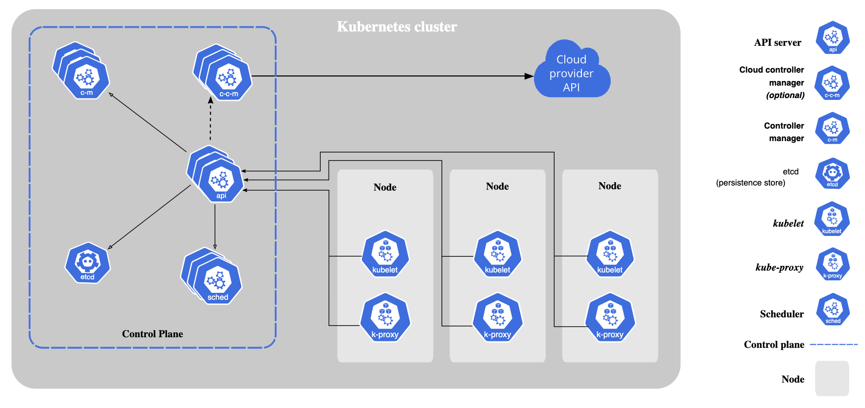
Recall: Overall K8 Architecture

Slide 6
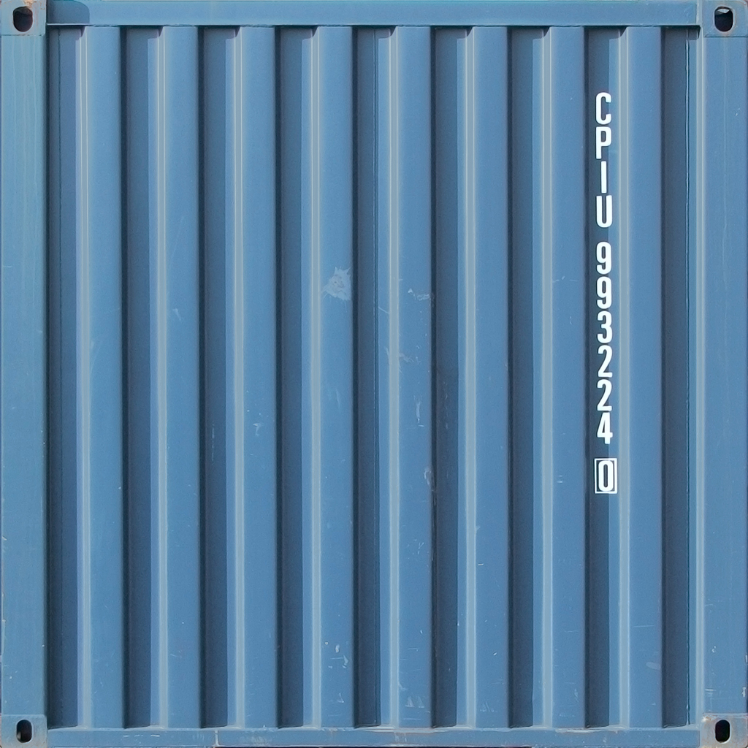
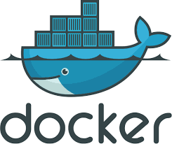
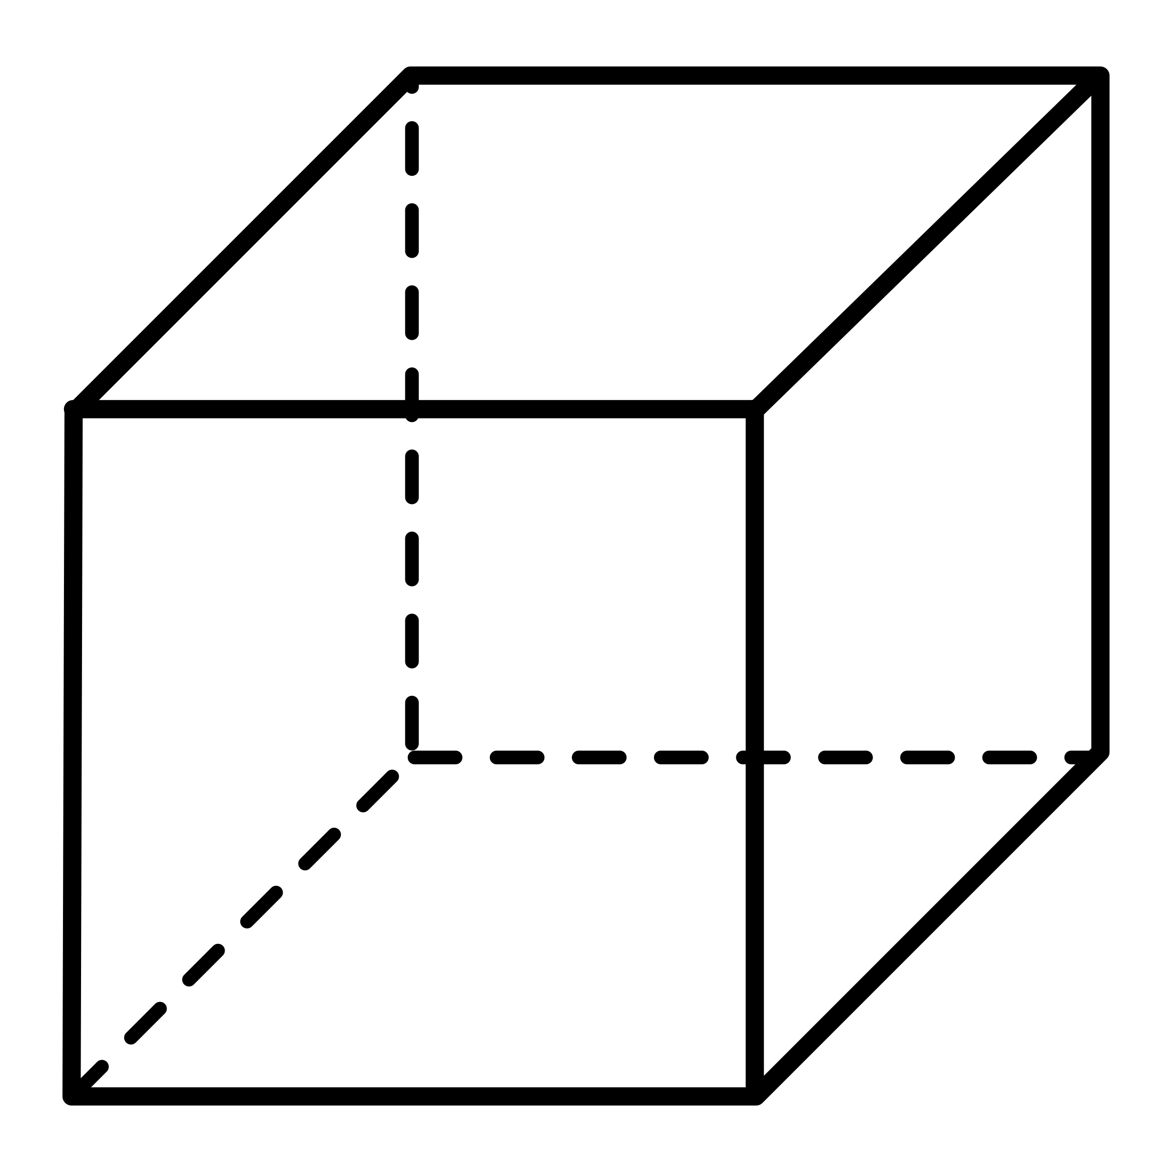
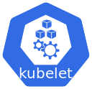
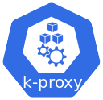
Recall: Nodes, ReplicaSets
Nodes are worker machines in K8s cluster
ReplicaSets are exact copies of nodes
Each node has multiple pods on it
Pods host application code via container images
How does the pod know what image to use?
Pod
Pod
Service
my-app
my-app
Pod
Pod
Service
database
database
Node 1
Node 2

Slide 7
Template
apiVersion: apps/v1
kind: Deployment
metadata:
name: nginx-deployment
labels:
spec:
replicas: 2
selector:
template:
metadata:
labels:
app: nginx
spec:
containers:
name: nginx
image: nginx:1.16
ports:
containerPort: 8080
Pods are configured inside of the deployment.
Defined in template
Template is the blueprint for a Pod
spec lists the container(s) that should be deployed in a pod, as well as the container port.

Slide 8
Labels and Selectors
apiVersion: apps/v1
kind: Deployment
metadata:
name: nginx-deployment
labels:
app: nginx
spec:
replicas: 2
selector:
matchLabels:
app: nginx
template:
metadata:
labels:
app: nginx
spec:
containers:
name: nginx
image: nginx:1.16
ports:
containerPort: 8080
Metadata contains labels
Labels give a component a key-value pair
e.g. app: nginx
This will stick to the component you’re deploying
Anything tagged with that key-value pair can be grouped together automatically by the deployment.

Slide 9
Labels and Selectors
Selectors are applied to a service
Selectors make a connection between the service and the pods that should be associated with the service.
apiVersion: apps/v1
kind: Service
metadata:
name: nginx-service
spec:
selector:
app: nginx
ports:
protocol: TCP
port: 80
targetPort: 8080

Slide 10
Namespaces
Organize resources in namespaces: multiple namespaces in a cluster
Default: 4 Namespaces per cluster
kube-system: Do not create or modify this!
System processes
kube-public: publicly accessible data
ConfigMap
kube-node-lease: heartbeats of nodes
default namespace: resources you create are located here
You can add and create new namespaces
$kubectl create namespace my-namespace
Add namespace in the config
apiVersion: apps/v1
kind: ConfigMap
metadata:
name: mysql-configmap
namespace: my-namespace
data:
db_url: mysql-service.database

Slide 11
Why Namespaces?
Group resources into Namespaces
Database namespace= db pods + resources
Monitoring namespace = Prometheus
Elasticstack namespace= Kibana
Nginx-Ingress namespace
Multiple Teams, One Cluster
Avoid having the same deployment with the same name!
One Cluster, Staging and Development in same cluster
Reuse components in both environments
Blue/Green Deployment
Host active and next version of application in same cluster
Limit Resources and Access to Namespaces when working with multiple teams
Teams can only deploy to their respective namespaces
Limit resource usage per namespace
Deployment will overwrite existing resources
Versions are different, but maybe they need to use some shared resources

Slide 12
Namespaces
Each NS must define its own ConfigMap and Secret
But you CAN share Service across namespaces
Some components can’t be can’t be namespaced
Volumes, Nodes

Slide 13
NameSpaces
If you don’t define a namespace, your resources will be assigned to the default namespace.
Best practice: set namespace in the config file, not using kubectl
Better documented
More convenient
Version control
apiVersion: apps/v1
kind: ConfigMap
metadata:
name: mysql-configmap
namespace: my-namespace
data:
db_url: mysql-service.database

Slide 14
Other Things to Know: Ingress Controller
Ingress Controller: Manages redirections; all requests to domain and subdomain that you’ve configured; third party implementations
CSPs: external requests coming from browser will first hit cloud load balancer; that will redirect requests to ingress controller
You don’t have to implement a load balancer yourself
Bare metal: have to configure this yourself.
Can be an external proxy server that will take the role of the load balancer and entry point
Proxy server → ingress controller → forwards to applicable services

Slide 15
Other things to know: Helm
Package manager for Kubernetes
What are some package managers we already work with?
Helm Chart
Bundle of YAML files; download and use existing Helm Charts
Where have we seen this kind of functionality before?
Charts are already available
Public and private registries (like container registries)
Templating Engine
Define a common blueprint
Dynamic values are replaced by placeholders
Template YAML config (right)
Values.yaml file provides the placeholders that you can use in template files
apiVersion: v1
kind: pod
Metadata:
name: {{ .Values.name }}
Spec:
containers:
name: {{ .Values.container.name }}
image: {{ .Values.container.image }}
port: {{ .Values.container.port }}

Slide 16
Data Persistence: What Are Our Requirements?
Deployment
Deployment
Pod
Pod
Pod
Pod
Service
Service
my-app
my-app
my-app
my-app
Pod
Pod
Service
Service
database
StatefulSet
database
Node 1
Node 2
Node 1
Node 2

Slide 17
Data Persistence: Handling Data with Volumes
Storage that doesn’t depend on the pod lifecycle
1
Storage must be available on all nodes
2
Storage needs to survive if the cluster crashes
3

Slide 18
Persistent Volume
apiVersion: v1
kind: PersistentVolume
metadata:
name: pv-name
spec:
capacity:
storage: 5Gi
volumeMode: Filesystem
accessModes:
- ReadWriteOnce
persistentVolumeReclaimPolicy: Recycle
storageClassName: slow
mountOptions:
- hard
- nfsvers = 4.0
nfs:
path: /dir/path/on/nfs/server
server: nfs-server-ip-address
A volume is a cluster resource (like CPU, RAM) that is used to store data
Created using YAML file
Needs actual physical storage
Local disk from cluster nodes
External network file system server
Cloud storage
S3, etc.
Persistent volume is an interface to other storage that you have to take care of.

Slide 19
Persistent Volume
External plugin to your cluster
Local or remote
Can have multiple volumes connected to your cluster
Depending on storage type, spec attributes will be different.
Volumes are NOT namespaced
Why?
apiVersion: v1
kind: PersistentVolume
metadata:
name: test-volume
labels:
zone: us-central1-a__us-central-b
spec:
capacity:
storage: 400Gi
volumeMode: Filesystem
accessModes:
- ReadWriteOnce
gcePersistentDisk:
pdName: my-data-disk
fsType: ext4

Slide 20
Persistent Volume Claims (PVC)
Local volume types are tied to a specific node
Developers need to claim a volume with a certain storage size or capacity and additional characteristics that they need for their app!
Use that claim in the pod configuration.

Slide 21
Volume Storage
ConifgMap and Secret are both stored in local volumes!
Not created via PV or PVC
They are created and managed by Kubernetes
Storage classes
Creates or provisions persistent volumes dynamically.
Also defined in YAML, abstracts underlying storage provider
apiVersion: storage.k8s.io/v1
kind: StorageClass
Metadata:
name: storage-class-name
Provisioner: kubernetes.io/aws-ebs
Parameters:
type: io1
iopsPerGB: “10”
fsType: ext4

Slide 22
Kubernetes In Real Life

Slide 23
Challenges: Scenario
Service container
Service container
EC2 Instance
EC2 Instance
8 containers for our application (divided into services)
To run our containers, we provision them on EC2 instances with Docker runtime installed on them.
How do we manage these VMs and containers?
How do we know if our resources (VMs) are still available?
How do we schedule where the next container will be launched?
What if our containers crash?
How do we manually restart each container?
How do we know when to remove unneeded replicas?
Service container
Service container
EC2 Instance
EC2 Instance
Service container
Service container
EC2 Instance
EC2 Instance
Service container
Service container
EC2 Instance
EC2 Instance

Slide 24
Options for Deploying Kubernetes
Just like with traditional cloud infrastructure, you can self-manage or use a cloud-managed solution.
Self-managed:
Create your K8 cluster in the cloud using VMs
Install, operate, manage environments with maximum control, flexibility, and customization
Relatively easy to start; much more difficult to scale
Cloud-managed:
CSP manages control plane nodes for you
You manage your deployments

Slide 25

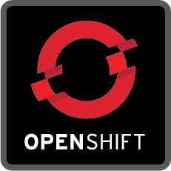
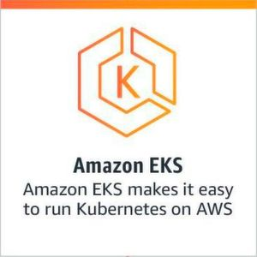
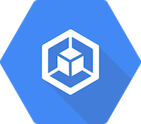
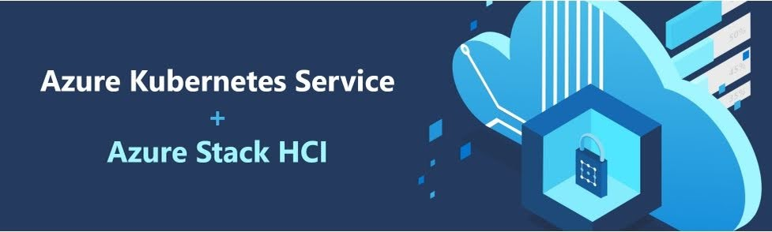
Managed Kubernetes Solutions
Amazon Elastic Kubernetes Service (Amazon EKS)
Azure Kubernetes Service (AKS)
Google Kubernetes Engine (GKE)
DigitalOcean Kubernetes Service (DOKS)
RedHat OpenShift

Slide 26
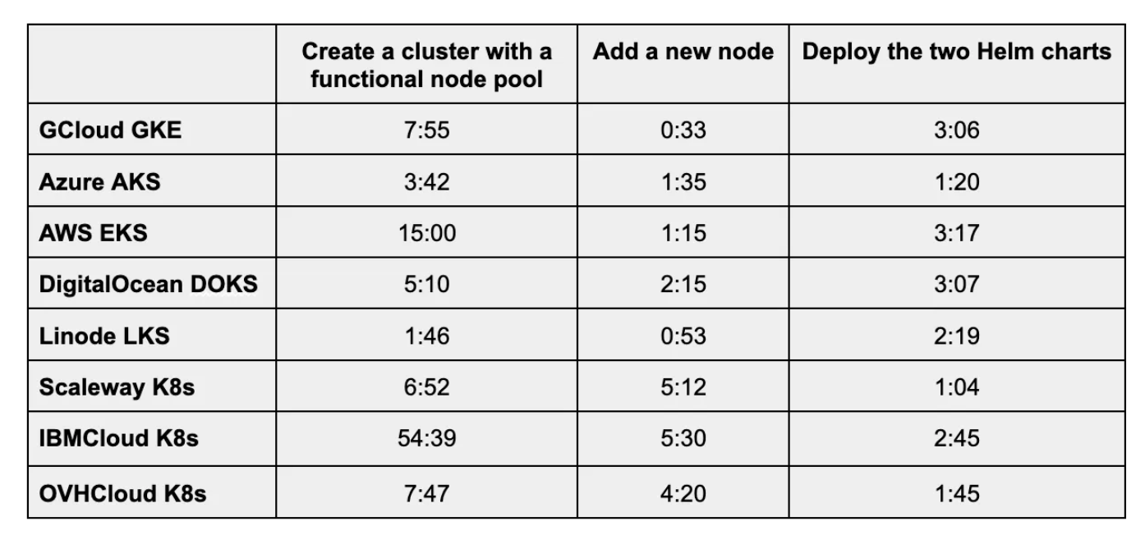
Comparison of Managed K8 Solutions
Performance
Source: Elliot Graebert

Slide 27
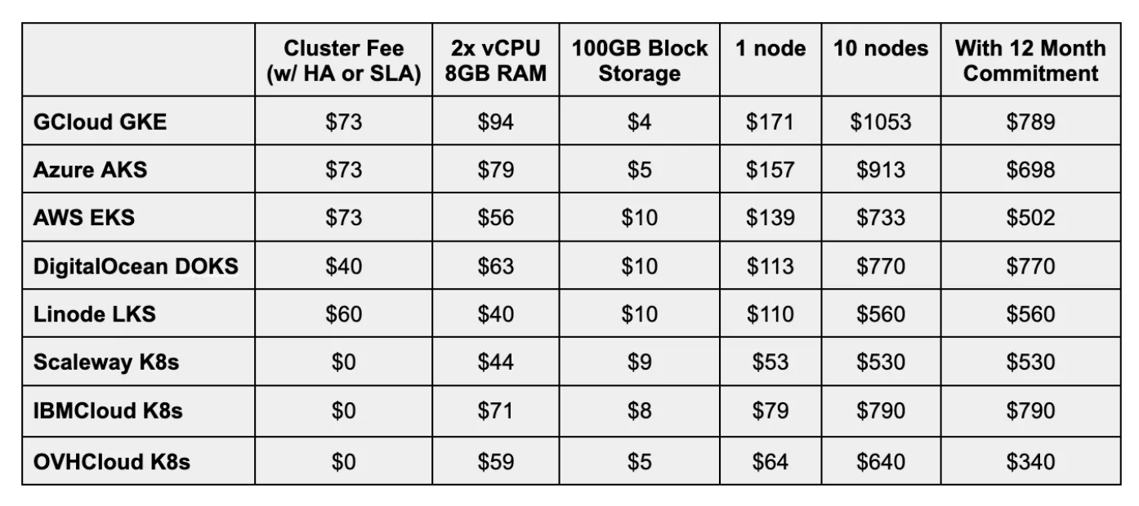
Comparison of Managed K8 Solutions
Costs
Source: Elliot Graebert

Slide 28
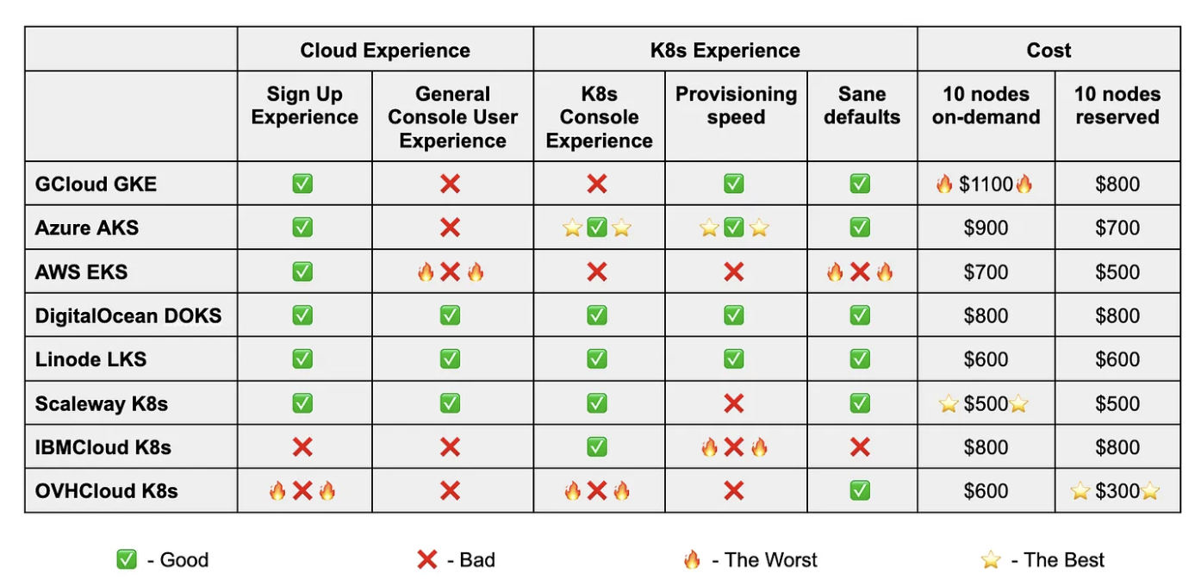
Comparison of Managed K8 Solutions
Overall User Experience
Source: Elliot Graebert; Terraform deployment for each provider here

Slide 29
Container Orchestration on AWS
An overview of the options

Slide 30
Containers on AWS
Containers scale quickly
Containerized applications need to incorporate third-party services
Messaging, authentication, etc.
Containerized applications need to be deployed in different environments

Slide 31





Container Services on AWS
Elastic Container Service
Elastic Kubernetes Service
EC2 and Fargate
ECR (Elastic Container Registry)

Slide 32
Container Services on AWS
Elastic Container Service
Elastic Kubernetes Service
EC2 and Fargate
ECR (Elastic Container Registry)

Slide 33
Deploying our Containerized Applications in the cloud
Containers need to run on actual machines (virtual or physical)
Where do these VMs come from?
EC2 instances (or Azure or GCP Compute VMs or DO droplets or whatever you like)
These instances host the containers and run them

Slide 34
Automation Tooling: amazon ECS
Amazon Elastic Container Service (ECS) manages the whole lifecycle of a container: start, re-schedule, load-balancing
Creates and runs an application cluster on AWS
This ECS Cluster has all the services necessary for managing containers
Represents a control plane for virtual machines that are running containers
EC2 instances are connected to your ECS cluster
Each instance has container runtime (e.g., Docker), and ECS agent installed

Slide 35
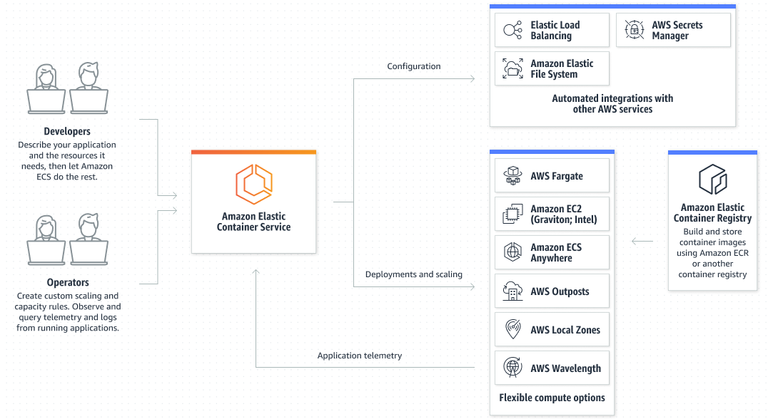
Amazon ECS

Slide 36
Benefits and Challenges of ECS
Benefits
Challenges
Full access and control of your infrastructure
Delegated management of your container to AWS service
Still have to manage the actual virtual machines:
Create the new instances
Join them to the ECS Cluster
Manage the operating system
Ensure Docker runtime and ECS agent is installed
Ensure each instance has enough resources to schedule the next container

Slide 37
ECS with Fargate
AWS Fargate: delegates management of our infrastructure to AWS
Alternative to managing EC2 instances
Instead of creating EC2 instances, use the Fargate interface, and Fargate will spin up VMs to run your container
“Serverless” way to launch containers

Slide 38
Fargate
Fargate will analyze what resources your container needs to run (CPU, RAM, Storage)
Fargate will automatically provision a server resource for that container and deploy and run the container
You don’t worry about your EC2 instances and resources
Always have only the amount of infrastructure resources needed to run your container
Pay only for the resources your container is consuming
Scales without fixed resources

Slide 39
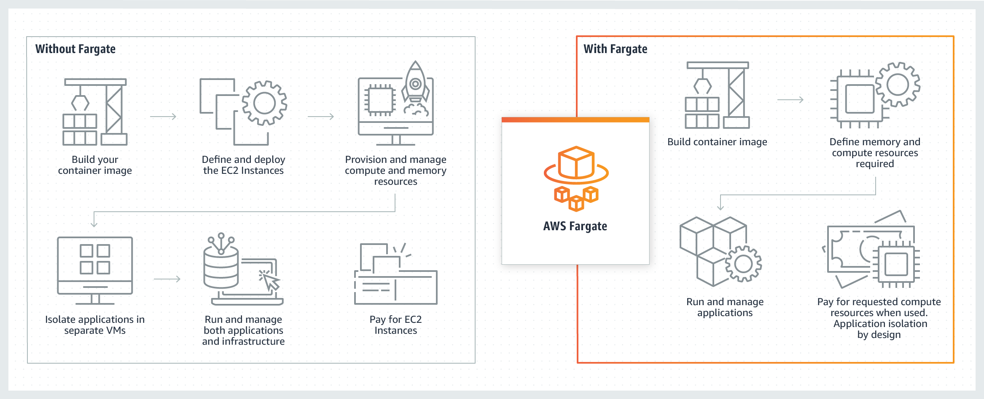
Fargate

Slide 40
Fargate
Infrastructure managed by AWS using Fargate service
Containers managed by AWS ECS
You only need to manage the application itself (your application source code and services)
Pricing is based on:
How long the container runs
How much CPU was requested to run that container

Slide 41
AWS Elastic Kubernetes Service
Alternative to ECS and Fargate
Manages Kubernetes clusters
Advantages:
Same K8 API
Kubernetes is open-source (ECS is specific to AWS)
ECS makes migration difficult
Easier to migrate to another platform*
Large community (Helm charts, etc)
For less complex application, use ECS
ECS control plane is free
*Migration off of EKS is hard because you’re probably using a lot of AWS Services

Slide 42
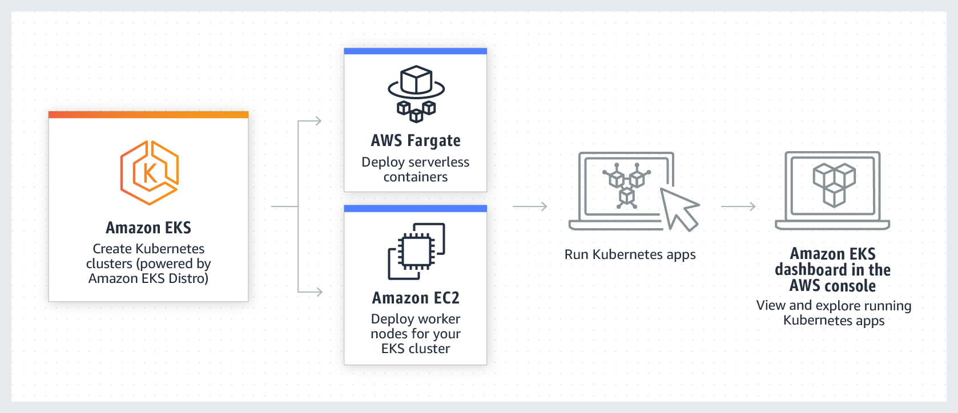
EKS

Slide 43
EKS
Create an EKS Cluster
AWS will provision Control Plane, with services already installed
High availability (replicated)
etcd: automatically replicated
To provision your K8 nodes, you create EC2 instances (compute fleet) and connect them to EKS

Slide 44
EKS Worker Node Options
EKS with EC2 Instances
Self-managed: you need to manage the infrastructure for Nodes
EKS with NodeGroup
Semi-managed: creates and deletes EC2 Instances for you, but you need to configure it
EKS with Fargate
Fully-managed: both Control Plane and Nodes are managed

Slide 45
Elastic Container Registry
Repository for container images
Alternative to Docker Hub
Integrates with other AWS Services
Create private repository for images, push different versions and tags to those registries
Use an endpoint to download images from the cluster

Slide 46
Service Mesh
Introduction

Slide 47
Service Mesh
Service mesh is a solution for managing communication between microservices in a microservice application
Istio is a popular open source Service Mesh designed to work with Kubernetes

Slide 48
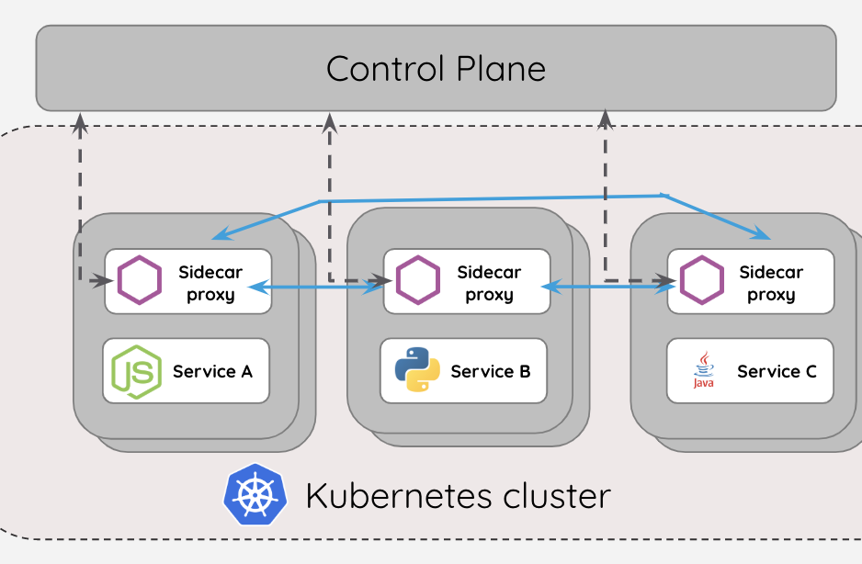
Service Mesh
A third party proxy service that abstracts networking logic from the microservice applications
Service Mesh has a control plane that will inject a proxy in every microservice pod
Network layer consisting of control plane and proxies is the service mesh

Slide 49
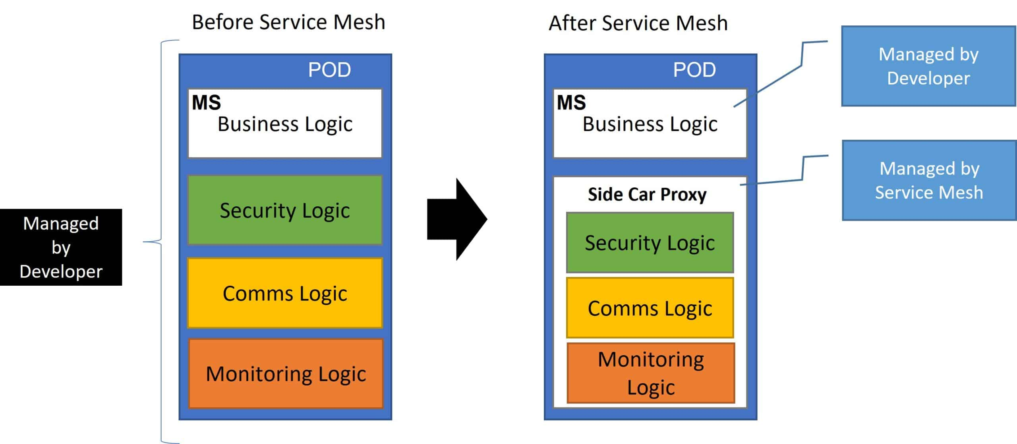
Service Mesh
Source: OpsMX

Slide 50
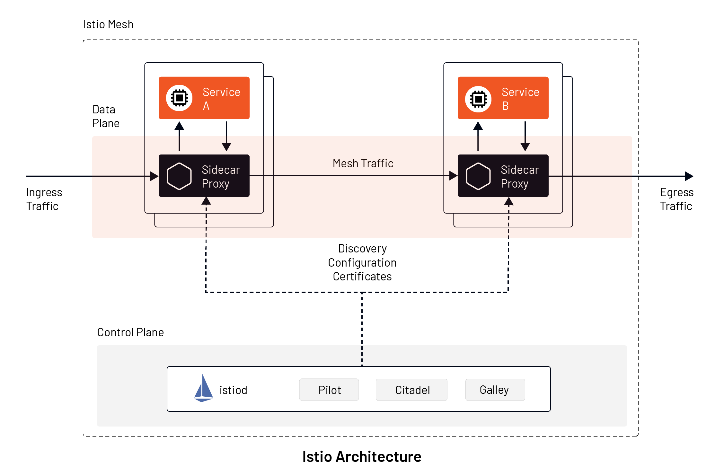
Istio Architecture
Proxies are called envoy proxies
Control plane component is Istiod
Injects envoy proxies in each microservice pods
Data Plane: group of the envoy proxies
Source: Tetrate

Slide 51
Kubernetes Case Studies
Please watch at your convenience

Slide 52

Kubernetes Case Study: CERN

Slide 53

Kubernetes Case Study: Bose

Slide 54

Kubernetes Case Study: US DoD

Slide 55
Land Acknowledgement Statement
We respectfully acknowledge the University of Arizona is on the land and territories of Indigenous peoples. Today, Arizona is home to 22 federally-recognized tribes, with Tucson being home to the O’odham and the Yacqui. Committed to diversity and inclusion, the University strives to build sustainable relationships with sovereign Native Nations and Indigenous communities through education offerings, partnerships, and community service.

